Slide 1


THE ASEA BREAKTHROUGH
AND OPPORTUNITY
Notes:
Begin by introducing yourself and telling your ASEA story. Tell how and why you came to be involved with ASEA--be sure to include your successes. This is your first chance to connect emotionally with your audience so be sure and talk about what spoke to you and moved you to enroll.

Slide 2


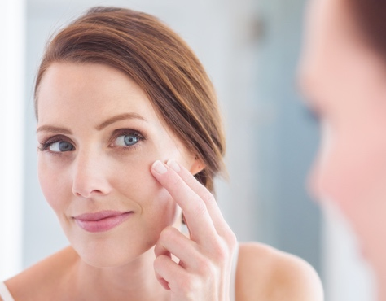
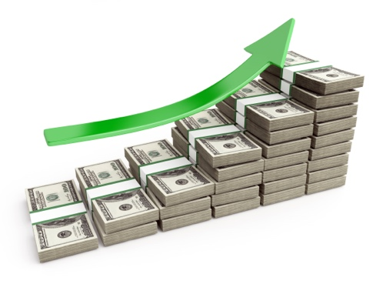
THE MOST SIGNIFICANT WELLNESS BREAKTHROUGH IN OUR LIFETIME
Wellness
Athletic Performance
Skin Care
AND WITH EVERY BREAKTHROUGH COMES INFINITE OPPORTUNITY
Notes:
Let’s get started by talking about a breakthrough—one so compelling that it has the potential to shift the course of human wellness for the future. I’d like to tell you about discovery so wide-reaching that it affects not only overall wellness but even the abilities of finely-tuned elite athletes. It even has an impact on our appearance—affecting the way we actually look! Would that be something you’d be interested in hearing more about? Do you think an innovation like this could result in an opportunity to create some income for those involved? For the next little while I’m going to share some data with you that has the potential to change everything!

Slide 3
HEALTH AT THE CELLULAR LEVEL
You live and die at the cellular level
YOU
When your cells are healthy, you are healthy
SYSTEMS
ORGANS
TISSUES
CELLS
REDOX SIGNALING
Notes:
Before we talk about that breakthrough, I need to give you a little background. Let’s talk about how our bodies work. We live and die at the cellular level. When our cells are healthy, the rest of us is as well, from our cells all the way up to through the rest of our bodies. Something called redox signaling, the communication between our cells, governs how all other systems of the body work. The science of redox signaling is only beginning to be understood but it is the subject of cutting-edge scientific research.

Slide 4



SCIENTIFIC VALIDATION
One of the fastest growing fields of scientific research
10,000+ peer-reviewed articles published on redox signaling
Notes:
In fact, multiple Nobel prizes have been awarded for discoveries related to this field of cellular messaging, and more than 10,000 scientific papers have been written on the subject.

Slide 5

WHAT IS REDOX SIGNALING
& HOW DOES IT AFFECT ME?
As we age, we produce fewer and fewer redox signaling molecules.
YOU WILL BEGIN TO SEE AND FEEL THE EFFECTS OF AGING
DEFICIENCIES AND IMBALANCES IN REDOX FUNCTION
Notes:
And what they have discovered is that redox signaling molecules are tiny cellular messengers that function at their best when we are young. In fact, the breakdown in cellular communication that accompanies aging can be seen as one of the main causes of aging itself!

Slide 6

REDOX BREAKTHROUGH
After extensive research, laboratory testing, and millions of dollars, a team of scientists achieved the “impossible.”
They stabilized redox signaling molecules outside of the body in perfect balance as they are found in healthy cells.
Notes:
Problem was, up until the innovation made by a company called ASEA, there was no way to supplement these redox signaling molecules. But after two decades and millions of research dollars, a team of scientists achieved the impossible: They stabilized redox signaling molecules outside of the body in as perfect a balance as they are found in healthy cells.

Slide 7



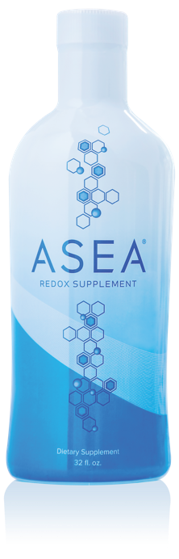
ASEA’S PATENTED 3 STEP PROCESS
Step 1
Pristine saltwater (same as found inside your cells)
Step 2
Saltwater broken down into free floating atoms
(Na-CI-H-O)
Step 3
Atoms restructured into stabilized redox signaling molecules
Notes:
These redox signaling molecules are found in ASEA’s flagship product, ASEA Redox Supplement, and exist in a matrix of salt and water. In a proprietary process, ASEA takes sterile saltwater and creates these important cellular messengers.

Slide 8



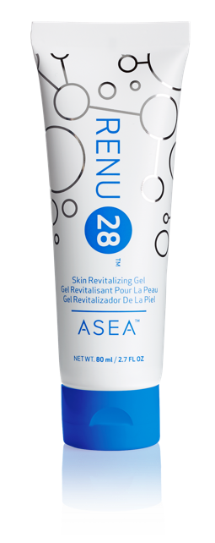


ASEA is the ONLY place
in the world where you can get these two exclusive, breakthrough products.
100% Safe
Non-Toxic
Notes:
ASEA’s products are a result of this heavily patented, groundbreaking technology. And they are certified by a prestigious third-party lab to contain active redox signaling molecules (Call out BioAgilytix certification.)

Slide 9

The most advanced anti-aging skin therapy ever brought to market.
Simple
Safe
Proven
Affordable
Effective
Notes:
Let’s take a look at RENU 28 Skin Revitalizing Gel, another of ASEA’s redox-based products. It is simple, safe, proven, affordable, and effective.

Slide 10
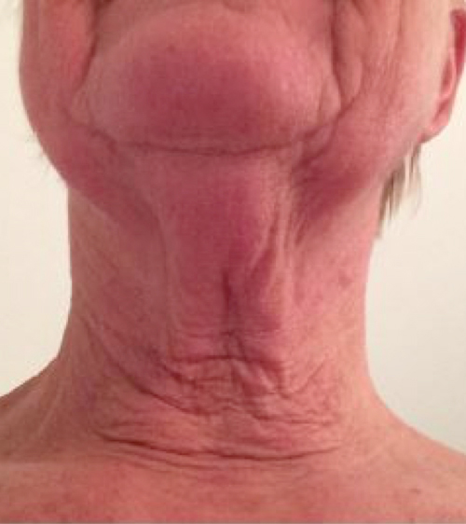
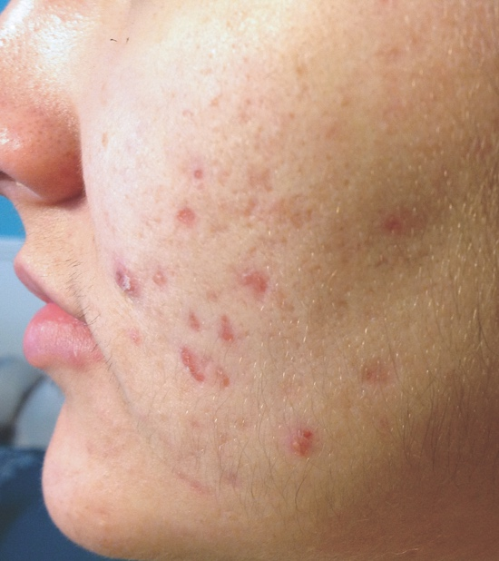
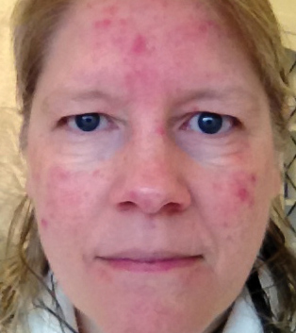
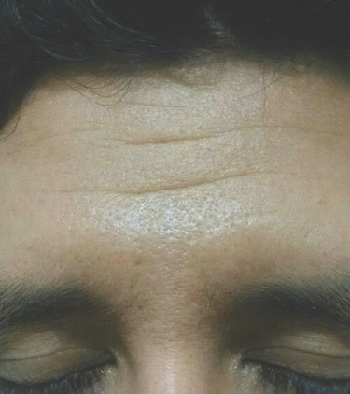
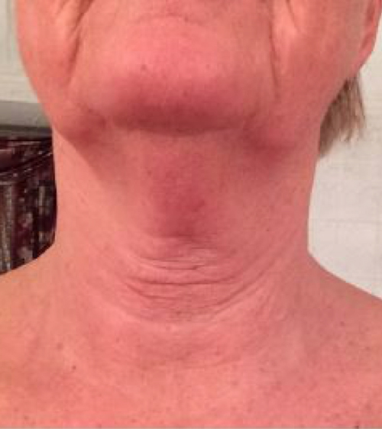
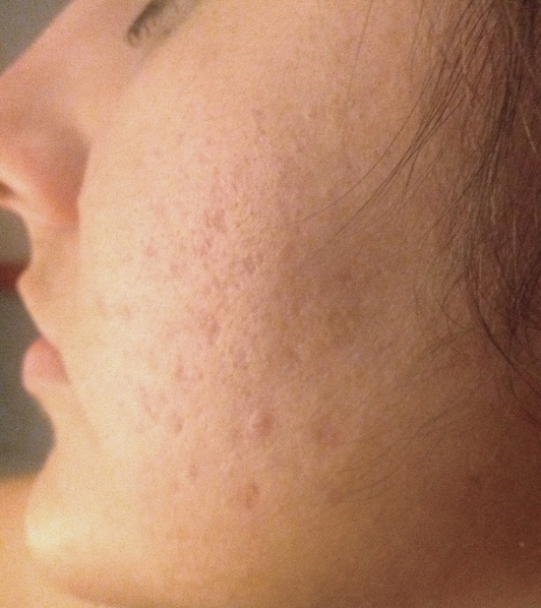
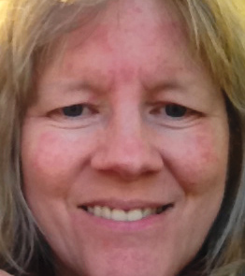
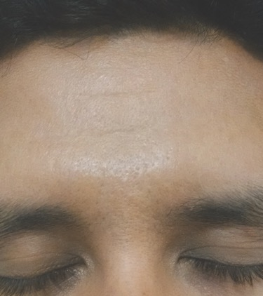
Notes:
Look at these other amazing before and after photos.

Slide 11

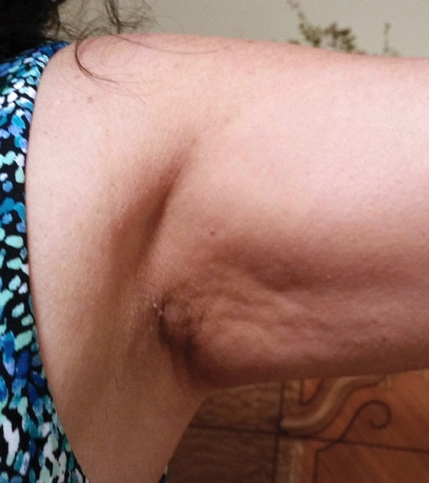
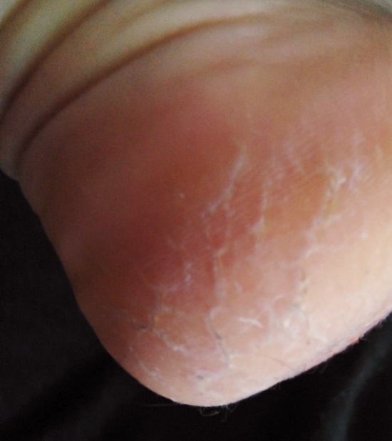
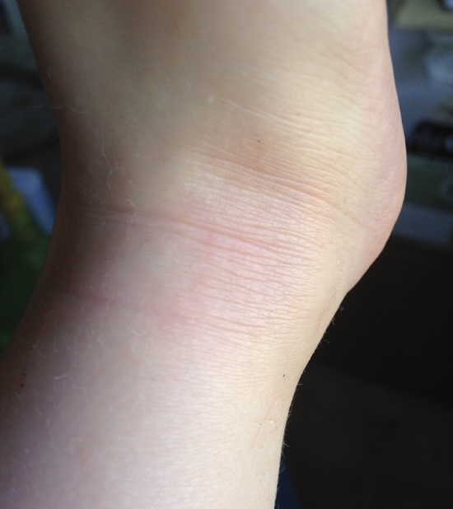
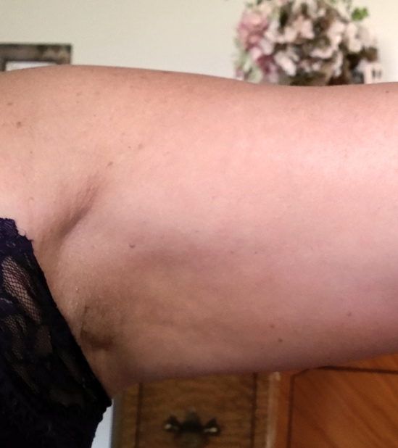
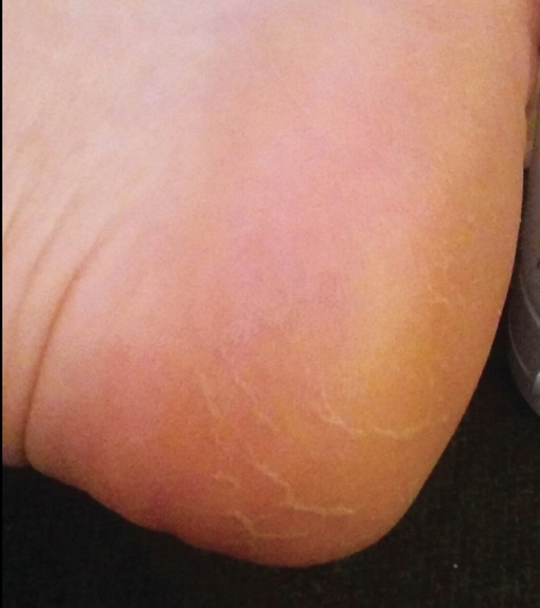
Notes:
And RENU 28 is not just for the face!

Slide 12
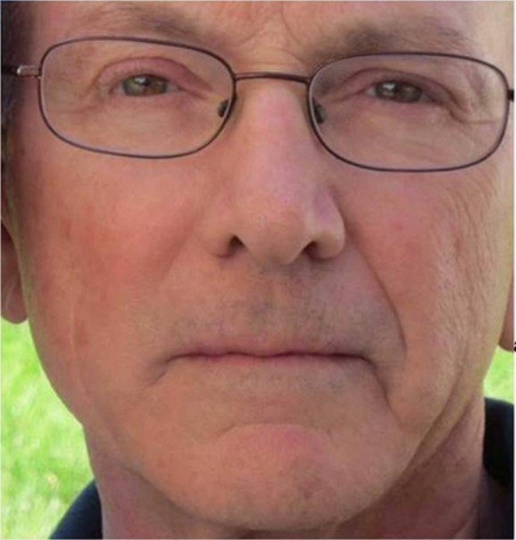
RENU 28 RESULTS
28 Days applying RENU 28
NO
RENU 28
Notes:
Take a look at Dr. Marty Morin’s personal results with RENU 28. This photo shows the treated and untreated sides of his face. Can you tell which is which? If you think he used it on the right side, raise your hand. Now, if you think he used it on the left. If you said right, you’re right.

Slide 13
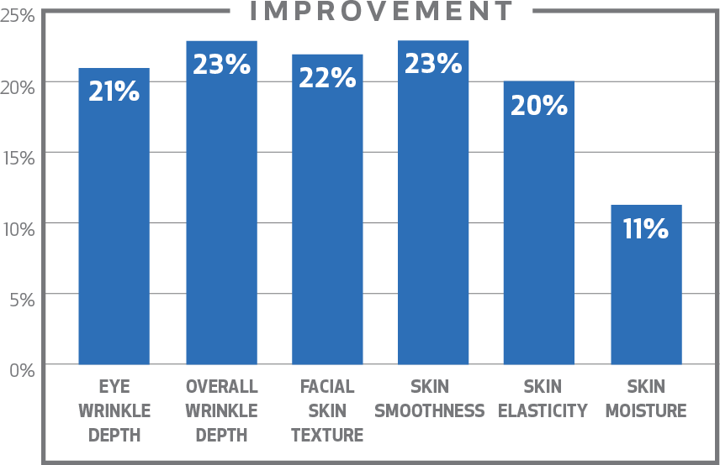


RENU 28 VALIDATED BY SCIENCE
Non-toxic; safe for the whole family
20% improvement in appearance of wrinkles and elasticity
Visible reduction in redness
and irritation
16% faster skin cell renewal
50% increase in skin blood flow
15% improvement in the appearance of cellulite
Stephens
Excellence in Research
Notes:
Studies prove it, showing that RENU 28 improves the appearance of lines and wrinkles associated with aging, increases skin cell renewal, and increases blood flow to skin.
Check out this last bullet point—RENU 28 helps improve the appearance of cellulite. Lets take a closer look at that—and I need to warn you—ladies, where is it that most people notice cellulite? Yep, the bum. So you are going to see some bums in this next slide.

Slide 14
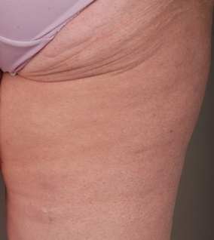
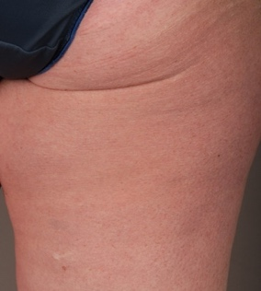


DERMATEST 12 WEEK CLINICAL STUDY
Results reveal:
20.91% increase in skin elasticity
15.81% improvement in the
appearance of cellulite
Notes:
Here are the latest results from a third-party clinical study performed on our products effectiveness at reducing the appearance of cellulite
Click
And here are some before and after photographs from the study.

Slide 15
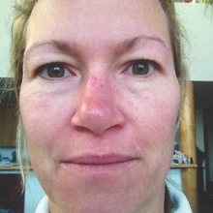
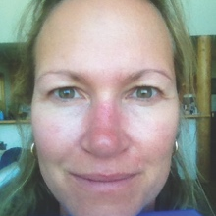
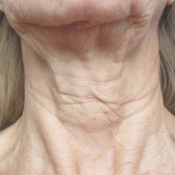
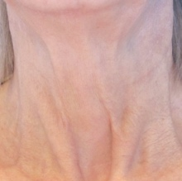
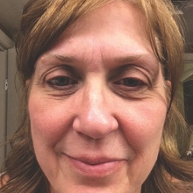
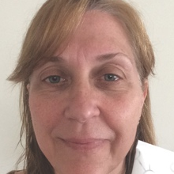
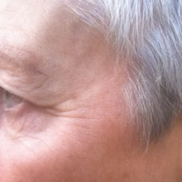
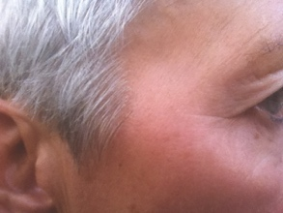
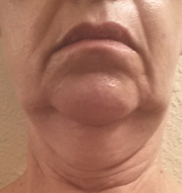
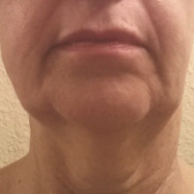
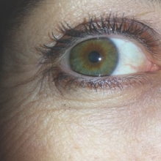
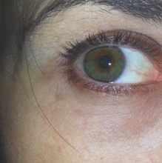
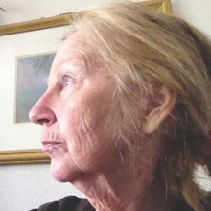
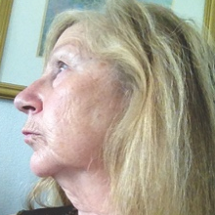
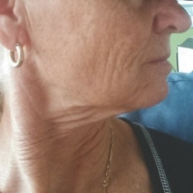
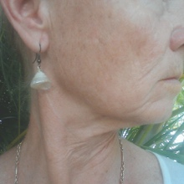
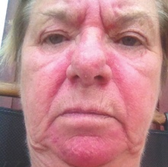
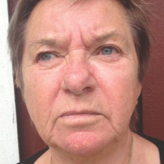
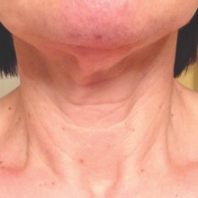
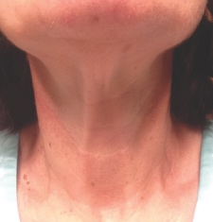
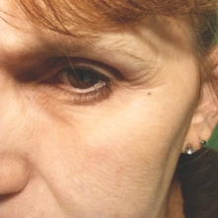
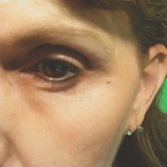
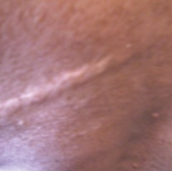
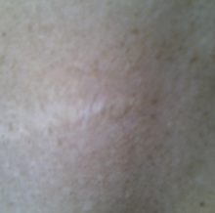
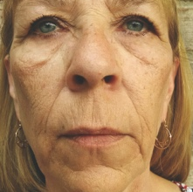
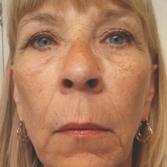
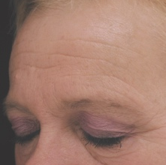
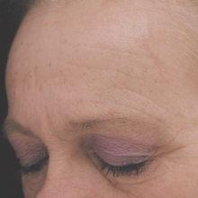
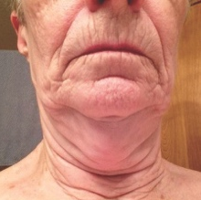



SEEING IS BELIEVING!
Notes:
And we have masses of these kinds of pictures! RENU 28 is having a significant impact on thousands and thousands of people!

Slide 16

The Most Significant Wellness and Athletic Breakthrough of our Lifetime
Notes:
Now let’s look at ASEA Redox Supplement. This is the flagship product, and it provides benefits from the inside out.

Slide 17

WHY YOU NEED ASEA REDOX SUPPLEMENT
Redox Signaling Molecules regulate every major body system
Activate antioxidants
Provide critical cell-to-cell communication
Empowers your body’s natural renewal processes to function optimally
Powerful anti-aging benefits
“This technology has the potential to spearhead the greatest advances in health we have ever seen.”
-Dr. Gary Samuelson, Ph.D
Notes:
The redox signaling molecules in ASEA Redox Supplement benefit every system of the body. They can actually upregulate important antioxidants, provide critical cellular communication, and improve athletic performance and recovery.

Slide 18


ASEA REDOX SUPPLEMENT
SIGNIFICANT IMPACT FOR ATHLETES
Endurance
Strength
Recovery
Mental Stamina
Notes:
Elite athletes also feel the ASEA difference. Here are a few of the many world-class athletes benefitting from ASEA Redox Supplement.

Slide 19






ASEA ATHLETES

Slide 20



Cody Miller
Olympic Swimmer
Reigning U.S. National Champion, 100-meter breaststroke
Dane Rauschenberg
Marathon Runner
Average marathon time
of 3:21:15
Gerard Louis Robert
World-renowned cyclist
9-time World Masters
Track Champion.

Slide 21



Kathy Waite
Triathlete
World and USA National Championship XTERRA Triathlete
Eddie Hall
Strongman
UK's Strongest Man
World record in the deadlift with straps
Damien Shaw
Cyclist—Team ASEA
Irish National Champion

Slide 22

ADVANCED ANTI-AGING TECHNOLOGY
Feel Better with ASEA
Anti-Aging from the Inside Out
Look Better with RENU 28
Anti-Aging from the Outside In
Harnessing the Power of
Redox Signaling Molecules
Notes:
Hopefully you can see how cutting-edge these products are, really seeing the nature of these products, the kind of demand we’re talking about, how they will work for you, and the proven science behind them.
(This is a great place to have people from your team talk about the positive impact ASEA Redox Supplement has had on their health.)

Slide 23

BREAKTHROUGH
CREATES OPPORTUNITY
Imagine having the single greatest breakthrough in wellness, athletics, and skin care.
NO COMPETITION. NO COPY CATS.
Notes:
As with any life-changing discovery, there is an amazing opportunity associated with ASEA’s breakthrough.

Slide 24



FOUNDATION OF INTEGRITY
Verdis Norton
Tyler Norton
James Pack
Verdis Norton, Tyler Norton and James Pack bought a compelling technology from a struggling biotech company as a business investment.
Examining the technology more closely with a team of researchers,
they discovered how to take the technology to a new level by stabilizing the molecules.
Notes:
Let me tell you a little about the founding of ASEA. It was born out of an idea that was little more than a business strategy: take a cool product concept, develop it, and sell it. But what the founders of ASEA didn’t know was the difference that this product would make in the lives of the people who used it. Once they saw that, they knew they couldn’t just move on. They actually passed on an opportunity to sell the technology to a major pharmaceutical company because they had a vision of reaching more people. They chose the network marketing business model for bringing redox signaling technology to the world.

Slide 25

ASEA STORY
Founders shared the original redox signaling product with a few family and friends.
Family and friends shared the profound benefits they were experiencing.
Soon, over a hundred people in multiple countries were benefitting from the product.
A multi-million dollar offer was made by a pharmaceutical company.
Accepting the offer would mean that everyone benefitting from the product would no longer have access to it.
Founders agreed that keeping their friends and family members on the product was more important than accepting the offer and immense profit.
What began as a simple business venture became a purpose-filled mission to improve lives around the world.
Notes:
Here’s how it all started (read bullet points).

Slide 26

How do we tell the world This Powerful Technology Exists?

Slide 27
MARKET CHANNEL EFFECTIVENESS
FOR NEW CUSTOMERS
25
20
15
10
5
0
SEO
Email
PR
Mobile
Radio
TV
WOM
Online Dir
Poster
Local Dir
PPC
Newspaper
Notes:
Let’s take a look at some numbers. This graph shows how small- to medium-sized business owners responded when asked the following question: Which of the following marketing channels is most effective at bringing you new leads and customers? You can see that, hands down, the best method was word of mouth (shown on this chart as WOM).
WOM—word of mouth
SEO—search engine optimization
Online Dir—Online Local Directories
Email—email marketing
Poster--Flyers and posters
PR—Traditional PR
Local Dir—Local paper directories
Newspaper—Local newspaper advertising
Mobile—mobile marketing
PPC—Pay Per Click advertising
Radio—Local radio advertising
TV—Local TV advertising
https://www.brightlocal.com/2015/01/07/37-smbs-plan-spend-internet-marketing-2015/

Slide 28

THE POWER OF A
NETWORK MARKETING BUSINESS
Building a network of distribution for products and services, using the oldest and most efficient form of advertising--word of mouth--a proven business model for nearly a century.
Notes:
And word of mouth is the most important principle in a business model called network marketing—a business model in which you build a network of distribution for products and services using the oldest and most efficient form of advertising: by telling people about it. This proven business model has been successful for over a century.

Slide 29



GLOBAL ENTREPRENEURS EMBRACE NETWORK MARKETING
Warren Buffett
Robert Kiyosaki
Did you know that 52%
of small businesses in
the US (fewer than 500 employees) are home-based?
Notes:
Something that you may not be aware of is that network marketing is becoming more mainstream. In fact, according to Forbes Magazine, over half of the small businesses in America are home-based businesses.
There are even 18 publicly traded direct selling companies on the NYSE, and they are performing WELL. Warren Buffet, widely acknowledged as the most successful investor of all time, is investing in network marketing. And well known businessman Robert Kiyosaki has long recognized the power of networking.

Slide 30

POWER OF NETWORK MARKETING ACKNOWLEDGED
World Renowned Economist Paul Zane Pilzer
Author of 9 best-selling books
Citibank's youngest vice president at age 25
Professor at New York University at age 24
Economic advisor in two U.S. presidential administrations
Advocate for Network Marketing
“I see great opportunities coming for the network marketing industry because network marketing is clearly the best vehicle we have today, in the United States and around the world, to educate people about new products and services”
Notes:
World renowned economist, Paul Zane Pilzer, also advocates for network marketing: (read quote).

Slide 31

BENEFITS OF NETWORK MARKETING
Be your own boss
Low start-up costs
Flexibility and time freedom
Work with like-minded entrepreneurs
Personal and professional training and development
Opportunity to earn part-time,
full-time, or legacy income
Network marketing allows you to enjoy the benefits of owning your own business without taking on the risks of a traditional business.
Notes:
There are a few reasons why more and more, people are compelled to try network marketing. Here are a few: (Read bullet points on slide.)

Slide 32

The network marketing industry
Notes:
So let’s spend a moment talking about the network marketing industry.

Slide 33




GLOBAL NETWORKING INDUSTRY
$183 BILLION
U.S. Music Industry
$16 billion
Sports & Energy Drink Industry
$52 billion
Global Skincare Industry
$79 billion
US Movie Industry
$80 billion
Notes:
This is an industry that is growing rapidly in both acceptance and size globally.
Just as a basis for comparison, look at these other high-revenue industries. Global network marketing sales are larger than any of these!

Slide 34
Pays out $73.2 billion a year, $6.1 billion a month, $200 million per day—and growing! Up 57% in the last 5 years!
Notes:
You can see that our industry is paying out nearly as much money per year as the largest of these other industries brings in! And these numbers are growing at an astronomical rate as more and more people across the globe decide to take control of their finances.

Slide 35










AN EXTRAORDINARY
OPPORTUNITY FOR EVERYONE
CONSTRUCTION WORKER
HOMEMAKER
ARTIST
MEDICAL
DOCTOR
FINANCIAL ADVISOR
WAITRESS
BODYBUILDER
RECEPTIONIST
SKI INSTRUCTOR
SINGLE MOM
Notes:
Network marketing can be an extraordinary opportunity for everyone. The professions you see listed here are actually past occupations of some of our current Diamonds. (this is a great place to add testimonials from successful ASEA associates or show a video of your upline such as an I Am ASEA video or Advisory Council member video)

Slide 36

HOW DO YOU CHOOSE A
COMPANY TO PARTNER WITH?
There are over 3,000 network marketing companies worldwide.
Notes:
But with more than 3,000 network marketing companies out there, how do you choose? Know this: not all network marketing companies are created equal. And that is really what I want to focus on today.

Slide 37






PRODUCTS
PARTNERSHIP
COMPENSATION
PLAN
SYSTEMS & SUPPORT
TIMING
Notes:
I want to talk to you about some of the advantages that my company, ASEA, has to offer.

Slide 38


THE PRODUCTS
ONE OF
A KIND
CUTTING EDGE
MASSIVE DEMAND
HIGH IMPACT
VALIDATED
PATENTED
Notes:
ASEA’s products are a key part of what make the opportunity so compelling. Think of it this way. When deciding on an opportunity to market a product, what would be important to you? Would you want products that are one of a kind, cutting edge, in massive demand, and that have a high impact? What about something consumable? You want people to need more, right? And it’s probably safe to say you would want it to be valid, maybe even patented.

Slide 39


PARTNERSHIP
World-class leadership
Financially strong and stable
International Presence
Notes:
And what kind of business partner would you want? One with (read bullets).

Slide 40















ASEA SENIOR LEADERSHIP
Charles Funke
CEO
Jarom Webb
President
Kurt Richards
Executive VP
Craig Dalley
Senior VP of Sales
Scott Aldred
Senior VP of Global Operations
Karen Reilley
Regional Sales VP
Justin Wilson
Regional VP Europe
Steve Davis
VP of Global IT
Dave Wall
VP of Global Finance
Ben Tyler
Corporate Counsel
Adolfo Avalos
Managing Director
of International Expansion
Becky Cox
Managing Director
of Marketing
Bob Freeze
Managing Director
of Public Relations
Karl Anderson
Senior Director
of International Operations
Duvan Botero
General Manager, Mexico
200+ years of industry experience
Notes:
ASEA’s leadership team has the power and know-how to drive the company forward.

Slide 41



FINANCIALLY STRONG & STABLE
Profitable every year since inception
Carries no debt
Scalable infrastructure—
capacity of $800 million
Highest quality standards (FDA registered, GMP, NSF compliant production facility)
Notes:
ASEA is strong and stable. Profitable every year since its birth, the key business indicators show that ASEA is ready for years of solid growth.

Slide 42

ASEA MARKETS WORLDWIDE: 25
Notes:
Take a look at the international markets where ASEA is available and operating. You are not limited by international boundaries. Everyone in this room should be thinking, “Who do I know in those countries?”

Slide 43

COMPENSATION
Leveraged Income
Residual Income
Part Time or Full Time
Legacy Income
Commissions Paid Weekly
Notes:
Let’s talk for a moment about how you actually make money with ASEA. This is called the compensation plan, and ASEA’s is one of (if not THE) most generous out there, profitable at every stage of the business cycle.

Slide 44
PILLARS OF COMPENSATION
Fair and generous
Pays weekly
Something for everyone
CHECK MATCH
EXECUTIVE MOMENTUM POOL
TEAM COMMISSIONS
DIRECTOR BONUS
FAST START
CUSTOMERS
RETAIL
IMMEDIATE INCOME TO PART TIME
FULL TIME TO UNLIMITED INCOME
Notes:
Here are the seven different ways you can make money at ASEA. You can see them divided here into categories—Immediate to Part Time, and Full Time to Unlimited, or as we like to call it, Big Time income.
Let’s take a look at just one: team commissions. Again, this is just one of the seven ways you can get paid with ASEA and, as a side note, it’s not even the most lucrative commission mechanism in the pay plan.

Slide 45


ASEA INCOME IS POWERFUL
LEVERAGED Income
Earn beyond yourself and build a distribution network of like-minded, self-motivated people … just like YOU!
RESIDUAL Income
Industry-leading retention rates mean repeat purchasing over time
Cutting-edge, consumable products
Meaningful results in people’s lives
No competition, no copycats!
Notes:
ASEA helps you create income that is both leveraged and residual. Let’s talk about why this is such a powerful income opportunity. First, leveraged income allows you to work together with a team because you’re leveraging the efforts of others. In all businesses, when somebody buys something, somebody gets paid. If you made that connection, why shouldn’t it be you being paid? ASEA makes sure that happens. You make a retail profit on every sale you facilitate.

Slide 46





WHAT DO YOU WANT TO ACHIEVE?
Bronze
Gold
Platinum
Triple Diamond
ASEA has paid out over $100 million to thousands of Associates. Multiple millionaires!
Notes:
Here’s what I’m telling you: the ASEA opportunity can be for you what you make it.
At the Bronze level, you can bring in enough to pay a mortgage.
At Gold, it’s enough to pay college tuition.
At Platinum, you’re making, say, what a lawyer makes.
And a Triple Diamond, you might be making what a well-paid surgeon makes.

Slide 47






RICH REWARDS
Notes:
Here are some photos of our most successful associates.

Slide 48


SYSTEMS AND SUPPORT
You are not alone
Personal development
Events and incentives
Your team
New friendships/relationships
Notes:
When you join ASEA, you become part of us. You will be able to participate in the local ASEA community via your team.

Slide 49



ASEA WORLD-CLASS TOOLS AND BACKOFFICE REPORTING
Starter Kit
ASEA
Business Coach
Back Office
Notes:
ASEA provides professional tools and training so that even the newest business partner can succeed.

Slide 50



ASEA’s personal development roadmap to success.
Notes:
One of the many success strategies the company embraces is its Peak Performance Program, the roadmap to success.

Slide 51








Notes:
You will participate in events and incentive trips and get to know corporate leaders as well as field leaders from other areas who are building their own businesses around the country and the world. And you will have the opportunity not only to participate in this community, but to help build it for your own team.

Slide 52


TIMING
Once-in-history timing
Notes:
Let’s talk about timing and why it is so important.

Slide 53


ONCE IN HISTORY TIMING
Are you ready?
Notes:
ASEA is a company that is just hitting its stride. What do you think of when I say post-risk, pre-momentum?
(pause)
ASEA has already taken the risk. The science has been proven. People all over the world are starting to take advantage. But we are still at the beginning of our growth momentum phase, and that is the right time to join. In fact, ASEA was recently recognized as being the 12th fastest growing company in the state of Utah—a state with one of the strongest economies in the country.

Slide 54

What’s next?
Notes:
So what’s next?

Slide 55



BILLION DOLLAR
REDOX TECHNOLOGY
THREE Massive Industries
No-one else has it
Almost no-one knows about it… YET!
Notes:
You have had the chance to learn about an amazing breakthrough today. How do you see it fitting into your life?

Slide 56



WHERE DO YOU SEE YOURSELF?
1
2
3
CONSUMER
Part-time builder
$500–$1000
Full-time builder
$10,000
and beyond
Notes:
Now that you’ve seen the ASEA opportunity and what it offers, the question is where do you see yourself?
1. Do you want to earn a few extra dollars? Enough to pay for your product?
2. What about a business opportunity that creates income—even enough to replace a full-time income?
3. Or a great wealth-building opportunity that can help you create a legacy?
Do yourself a favor. Tell person who brought you tonight where you see yourself. Are you a 1, a 2, or 3?

Slide 57
ASSOCIATE ENROLLMENT
Enroll as an Associate:
Activate with a One-Time Enrollment Pack
1 case
2 cases
4 cases (Discounted)
8 cases (Discounted)
Discounted packs ONLY available at time of enrollment.
Notes:
Here are a few of the options for getting started with ASEA. Several ways to enroll. 1 case, 2 cases, get with the person who invited you.

Slide 58


BONUS AUTOSHIP CASE PROMOTION
Only One Case Autoship to Remain Active
The Autoship incentive is for new enrollees through May 13, 2016
Enroll with
1 case minimum
(e.g. Jan)
+
=
1st Month Autoship
(Feb)
2nd Month Autoship
(March)
3rd Month Autoship
(April)
FREE CASE of ASEA or RENU 28
+
=
4th Month Autoship
(May)
5th Month Autoship
(June)
6th Month Autoship
(July)
FREE CASE of ASEA or RENU 28
Notes:
By enrolling today you can take advantage of our Bonus Autoship case promotion. When you enroll today with a 100PV Autoship order, you will be eligible to receive 2 CASES of product for FREE!!

Slide 59



RENU 28 GIVEAWAY PACK
Add 2 tubes of RENU 28
to a 1 case Autoship (150PV)
Giveaway Pack ($30 Value)
Get 6 FREE sample tubes of RENU 28 + RENU 28 booklet and brochures
Notes:
And we have another promotion going on currently: (explain promo)

Slide 60


We are all at the start of something big with great purpose and right now is the moment that we begin influencing the future…
We can change the world.
Verdis Norton, ASEA founder
Notes:
I’d like to close with some words from our founder, Verdis Norton (read quote).

