Slide 1
“Start by doing what’s necessary, then do what’s possible, and suddenly you are doing the impossible.” -SAINT FRANCIS OF ASSISI

Slide 2
SUCCESS GUIDE
A proven, easy-to-follow guide to quickly establishing your ASEA business and finding success.

Slide 3
Get a strong start with these proven steps to success. This checklist is for your first 48 hours of joining the ASEA team or receiving your starter kit. Do it, and you’ll be armed with the information you need to feel confident in approaching people and to build your business.
Getting Started Essentials
Enroll and order ASEA Builder Pack (includes Welcome Kit)
Enroll in ASEA autoship program
Review Welcome Kit
Complete your ASEA story (step 10)
Complete your own clarity and conviction statements (step 2)
Complete your goals for a successful ASEA business (step 3)
Become familiar with your ASEA virtual office
Review your top 20 prospect list with your sponsor to schedule invite appointments (step 4)
Become a Director (step 3)

Slide 4
Eight Steps to Success
Be Your Own Case Study
Clarity & Conviction
Set Goals & Make Commitments
Build a Prospective Team List
Contact & Invite
Sharing the ASEA Story
Collect a Decision
Duplicate Yourself

Slide 5
STEP ONE
Be Your Own Case Study
At ASEA we like to say, “Buy a case, and become your own case study.” To effectively share the ASEA story with others, it’s important that you experience real and personal results from using ASEA. You’ll then have a genuine and compelling reason why others should do the same.

Slide 6
Be your own case study
Use ASEA’s products
What can you expect?
The ASEA body inventory
Your ASEA story

Slide 7
Exercise
In five sentences or less, write down why you joined ASEA and share it with the person sitting next to you.

Slide 8
“What lies behind us and what lies before us are small matters compared to what lies within us.” -RALPH WALDO EMERSON

Slide 9
STEP TWO
Clarity & Conviction
The most valuable thing you could ever offer someone is the chance to join the ASEA team. The drive to offer this product to others requires clarity and conviction.

Slide 10
CLARITY What Do You Want from ASEA?
I want to retire with enough money so that I can travel the world.
I don’t want daycare to raise my children.
I want to develop as a person.
I am tired of working for someone else’s dream.
I am a hard worker and want to decide for myself when I work hard and when I play hard.
I want to be my own boss.
I want more flexibility in my day to spend with family and friends and be part of my community.

Slide 11
CONVICTION What Do You Believe?
ASEA products are making a profound impact and everyone in my life deserves products that improve their quality of life.
ASEA offers me training and support to develop personally, and with that training I can impact others.
Building an ASEA business will allow me to travel the world with my family and friends.
Residual and leveraged income improve the ability for me to be more flexible with my time.

Slide 12
Exercise
Take five minutes to write what you WANT from ASEA and WHY you want it, and take five minutes to share it with the person sitting next to you.

Slide 13
STEP THREE
Set Goals & Make Commitments
Specific, defined goals will solidify your plan to share ASEA with others.

Slide 14
Establish S.M.A.R.T. Short- and Long-Term Goals (Specific, Measurable, Attainable, Realistic, Time Bound)
Pay for product
$100–$500
Part-Time Income
$500–$5,000
Full-Time Income
$5,000–$10,000
Wealth-Building Income
$10,000–Unlimited

Slide 15
Time Management

Slide 16
Become Director in your first 14 days
Set a goal to become a Bronze Executive

Slide 17
How Will I Accomplish My ASEA Goals?
I will give out two prospecting tools every day.
I will do a three-way phone call daily.
I will attend my local, regional, and national meetings with a guest or member of my team.
I will reprioritize my time to include daily dedicated business building behaviors.
I will read or listen to books that build my self confidence or skill set daily.
I will review my goals daily.

Slide 18
Exercise
Write your 3 – 5 “I will” statements and your next income goal, rank goal, and sponsorship goal, and discuss it with the person sitting next to you.

Slide 19
STEP FOUR
Build a
Prospective
Team List
Identifying prospective associates with whom to share the ASEA opportunity is paramount to your success.

Slide 20
Strategies for Building an Effective Prospect List
List everyone you know— no prejudging!
Remember to network! Although a person may decline, they may know someone who might be interested.
Identify 100 names using the memory jogger on page 20.
The top 20 names on your list will be your first contacts.
Keep your list updated by adding names as you meet new people and checking back in with others after an appropriate amount of time.
Stay emotionally detached from the potential of your list.

Slide 21
Who do you know that is interested in ANTI-AGING? Someone who:
Wants to look younger
Wants to have more energy
Wants to sleep better
Follows current health trends
Takes care of their mind and body
Takes supplements and vitamins
Who do you know that enjoys:
Going to the gym regularly
Playing golf
Marathons or triathlons
Weekend runs
Hiking
Biking
Staying active
Think about your family, friends, and coworkers who:
Are moms and dads
Are middle-aged
Have families with two working parents
Have hectic and stressful schedules
Have health or financial struggles
Are concerned about their retirement
Enjoy traveling
Who do you know that is business-minded? Someone who:
Is looking for additional income
Owns their own business
Is interested tax savings
Has an entrepreneurial spirit
Enjoys healthy competition
Enjoys building teams

Slide 22
Exercise
Take five minutes to write down as many names as you can think of from the memory jogger. Turn to the person sitting next to you, share three names and why you wrote them down.

Slide 23
STEP FIVE
Contact & Invite
Using your prospective team list, you’ll begin contacting and inviting others to learn more about ASEA products and opportunity. For many people, this is the most difficult step in the process. However, with the help of your sponsor, and by following these guidelines, you’ll soon be very effective at inviting others to enjoy what you have with ASEA.

Slide 24
Did You Know?
Interested in Anti-Aging:
In the United States, someone turns 50 every seven seconds.
People 50 and older spend a lot of money – about $3 trillion.
Baby boomers in the United States spend $230 billion every year on consumable goods; that’s 55% of all the consumer goods sold.
Parents and Families:
Moms influence 85% of all household purchases.
Moms spend $2.1 trillion each year.
55% of mothers say they rely on recommendations when making a purchase.
Athletes:
Endurance sports (cycling, triathlon, marathon) are one of the fastest-growing sports segments, with 53% growth over the last 15 years.
The market of sports supplement sales exceeds $1.9 billion each year.
Health Minded:
The global health and wellness market is staggering – over $800 billion, soon to be $1 trillion.
Americans spend $70 billion a year on vitamins alone.
Many economists consider the health and wellness industry to be recession-proof.

Slide 25
SIFTING AND SORTING
Ask Questions
Listen
Pique Interest (not a presentation)
Practice
Practice
Practice

Slide 26
SCRIPTING
HOT
WARM
COOL
COLD

Slide 27
Exercise
Turn to the person sitting next to you and share a product and opportunity invitation for someone in a warm list.

Slide 28
STEP SIX
Share the ASEA Story
After you’ve invited your prospects to learn more about ASEA, present the full ASEA story with a tool.

Slide 29
Share the ASEA Story
Tools Duplicate; People Do Not
Live Presentations
Webinars
Zooms
Conference Calls
In-home parties
Hotel presentations
Sales Tools
Brochures
Booklets
Flyers
Tear Off Sheets
Videos
Product
Opportunity
Company
Compensation
Athletics
Personal Stories
Your story
Stories from others

Slide 30
Exercise
Turn to the person sitting next to you and tell them your ASEA Story in three minutes or less.

Slide 31
STEP SEVEN
Collect a Decision
It’s often said in network marketing that the fortune is in the follow-up. Most prospects won’t commit after receiving one presentation. It’s important to follow up with them and answer questions. This will help you collect a decision.

Slide 32
Collecting a Decision Example Questions
What did you like best about what you’ve seen?
On a scale of one to ten, where would you rate your interest in getting started?
How much money would you need to earn per month to make this worth your time?
What additional information would you need to get started?

Slide 33
Your Fortune Is in Your Follow Up
Keep Commitments
ASEA Business Coach
Day planner
Electronic planner
Be brief
Respect their time
Collect a Decision
Three-way call
Brochures
Videos
Conference calls/webinars
Understand how to enroll through your personal web page
Emotional Detachment
Learn to let go
Learn to hear no and move on
Collect referrals
Build a drip list
Be professional and enthusiastic
Ask Qualifying Questions
Listen more
Talk less
Stay on message
Learn the objectives of the other person

Slide 34
Exercise
Get in groups of three and each take a turn doing a three-way call. Each of you should take a turn as the expert, the guest, and the sponsor (the ABC model).

Slide 35
STEP EIGHT
Duplicate Yourself
Utilizing duplication in your building efforts will translate to tremendous success for both you and your group.

Slide 36
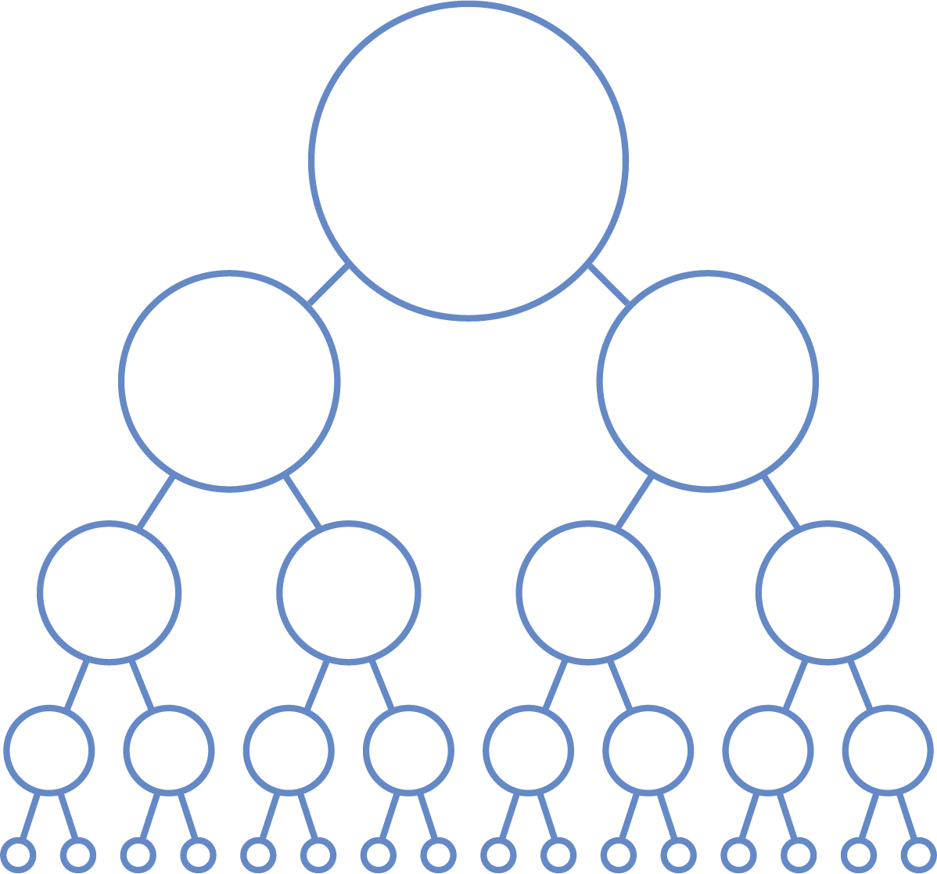
Duplication
In network marketing, duplication is the repetition of a certain system to effectively recruit and enroll prospects, and then to have them repeat the exact process with others.
The more simple, streamlined, and user-friendly your system is, the easier it is to duplicate.
As you utilize duplication in your efforts with your team, the more motivated, trained, and confident your team will be – which will ensure their success and yours.
Example: Teach 2 to Reach 2
You don’t need to personally enroll the world!
YOU
JACK
JILL

Slide 37
Success Activity
Create a list of 20 contacts, contact your sponsor/mentor and set up the next step of duplication for each of the 20. contact, invite or follow up with those 20 in the next four days.

Slide 38
“I would rather have 1% of the efforts of 100 people than 100% of my own efforts.” -J. PAUL GETTY

