Slide 1
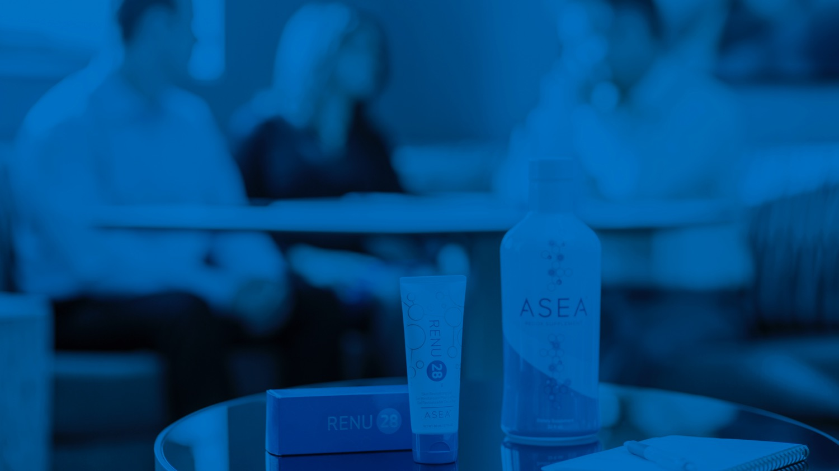

THE ASEA OPPORTUNITY
Notes:
Begin by introducing yourself and telling your ASEA story. Tell how and why you came to be involved with ASEA--be sure to include your successes. This is your first chance to connect emotionally with your audience so be sure and talk about what spoke to you and moved you to enroll.

Slide 2






DAILY ROUTINE
Notes:
Before we launch into the presentation, I want to ask you a few questions. First, I want to you to think about the daily grind. How do you feel at the beginning of the workday versus the end? Do you feel like you are making progress towards your long-term financial goals or that you are treading water? On a daily, hour-to-hour basis, do you have control over what it is you are doing? Could you use a little more flexibility in your schedule and money in your wallet? If the answer to any of these questions leaves something to be desired, then you should know that you are not alone.
(This is the perfect time to add your own ASEA financial success story, if you are comfortable sharing. If not, consider having your upline share their story—any real-life example of ASEA making a difference would be perfect)

Slide 3



YOU’RE NOT THE ONLY ONE
Earning 15% less than in 2000.
70% of Americans reported wanting to be their own boss.
$12,000 in average retirement savings.
*National Institute on Retirement Security
Notes:
More and more people are looking for a way to create more for themselves; more income, more time freedom, more security—something that gives them more control in their busy lives.
Bullet points:
Left: New college graduates are making on average 15% less than they were 15 years ago.
Middle: 70% of people report the desire to be their own boss.
Right: Americans have an average of $12,000 in retirement savings.

Slide 4

WHAT ARE YOUR OPTIONS?
WORK
— for —
someone
else
INVEST
— in a —
business
BUY
— a —
business
START
— a —
business
Notes:
If any of this resonates with you, then you have a few options. If you are employed right now, then you can just keep doing what you are doing and work for someone else. Maybe look for a job that gives you a little more flexibility or pay. If you have a chunk of cash in the bank, you might be able to buy a business or invest in one. For lots of us, though, the idea of STARTING a business has some real appeal.

Slide 5

STARTING A TRADITIONAL
BUSINESS? DO YOU HAVE
A unique idea in high demand?
$50,000–$500,000 in startup capital?
Business, financial and legal savvy?
Ability to commit at least 60-80 hours per week?
And keep in mind that fewer than 5% of new businesses make it to 5 years
Notes:
BUT to start a business the traditional way, we need a few things. A great idea, one that is different and in HIGH demand, and some startup cash. We need to understand how businesses operate, as well as have some financial and legal savvy. And let’s not forget the massive time commitment that new business owners face. And keep in mind that your business, statistically, is unlikely to make it past five years. Sound appealing now?

Slide 6

THE POWER OF A
NETWORK MARKETING BUSINESS
Building a network of distribution for products and services, using the oldest and most efficient form of advertising… word of mouth… a proven business model for nearly a century.
Notes:
I’d like to introduce you to network marketing—a business model in which you build a network of distribution for products and services using the oldest and most efficient form of advertising: word of mouth, a proven business model for nearly a century.

Slide 7
MARKET CHANNEL EFFECTIVENESS
FOR NEW CUSTOMERS
25
20
15
10
5
0
SEO
Email
PR
Mobile
Radio
TV
WOM
Online Dir
Poster
Local Dir
PPC
Newspaper
Notes:
Let’s take a look at some numbers. This graph shows how small- to medium-sized business owners responded when asked the following question: Which of the following marketing channels is most effective at bringing you new leads and customers? You can see that, hands down, the best method was word of mouth (shown on this chart as WOM).
WOM—word of mouth
SEO—search engine optimization
Online Dir—Online Local Directories
Email—email marketing
Poster--Flyers and posters
PR—Traditional PR
Local Dir—Local paper directories
Newspaper—Local newspaper advertising
Mobile—mobile marketing
PPC—Pay Per Click advertising
Radio—Local radio advertising
TV—Local TV advertising
https://www.brightlocal.com/2015/01/07/37-smbs-plan-spend-internet-marketing-2015/

Slide 8


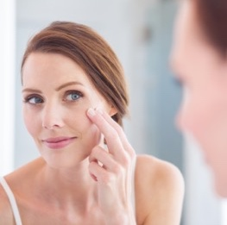

GLOBAL NETWORKING INDUSTRY
$183 BILLION
US Music Industry
$16 billion
Sports & Energy Drink Industry
$52 billion
Global Skincare Industry
$79 billion
US Movie Industry
$80 billion
Notes:
This is an industry that is growing rapidly in both acceptance and size globally.
Just as a basis for comparison, look at these other high-revenue industries. Global network marketing sales are larger than any of these!

Slide 9
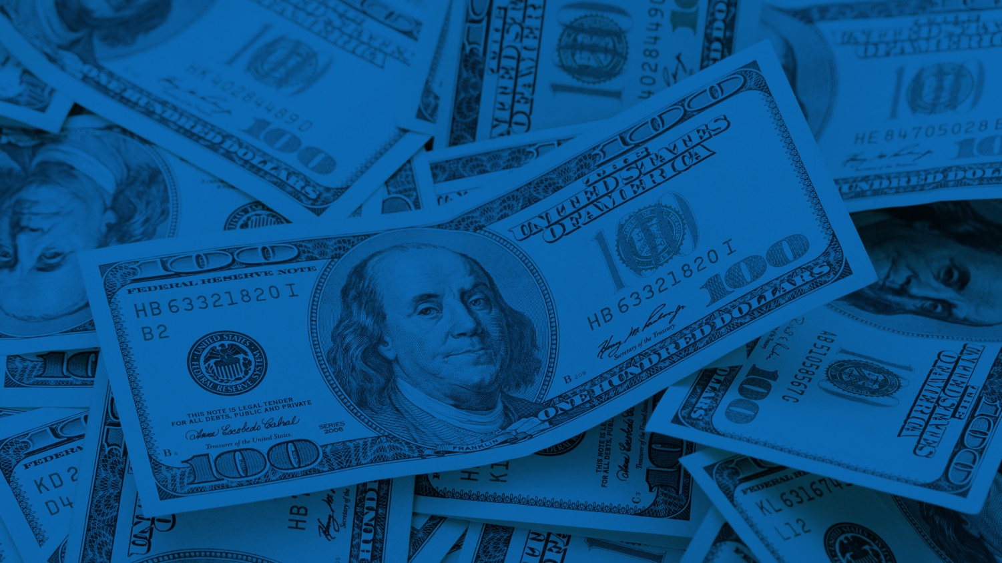
Pays out $73.2 Billion a year, $6.1 Billion a month, $200 Million per day—and growing! Up 57% in the last 5 years!
Notes:
Our industry is paying out nearly as much money per year as the largest of these other industries brings in! And these numbers are growing at an astronomical rate as more and more people across the globe decide to take control of their finances.

Slide 10
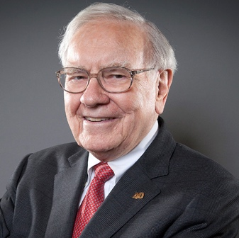

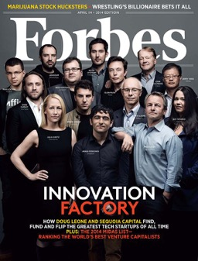
GLOBAL ENTREPRENEURS EMBRACE NETWORK MARKETING
Warren Buffett
Robert Kiyosaki
Did you know that 52%
of small businesses in
the US (fewer than 500 employees) are home-based?
Notes:
Something that you may not be aware of is that network marketing is becoming more mainstream. In fact, according to Forbes Magazine, over half of the small businesses in America are home-based businesses.
There are even 18 publicly traded direct selling companies on the NYSE, and they are performing WELL. Warren Buffet, widely acknowledged as the most successful investor of all time, is investing in network marketing. And well known businessman Robert Kiyosaki has long recognized the power of networking.

Slide 11

BENEFITS OF NETWORK MARKETING
Be your own boss
Low start-up costs
Flexibility and time freedom
Work with like-minded entrepreneurs
Personal and professional training
and development
Opportunity to earn part-time,
full-time, or legacy income
Network marketing allows you to enjoy the benefits of owning your own business without taking on the risks of a traditional business.
Notes:
There are a few reasons why more and more, people are compelled to try network marketing. Here are a few: (Read bullet points on slide.)

Slide 12









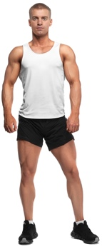
AN EXTRAORDINARY
OPPORTUNITY FOR EVERYONE
CONSTRUCTION WORKER
HOMEMAKER
ARTIST
MEDICAL
DOCTOR
FINANCIAL ADVISOR
WAITRESS
BODYBUILDER
RECEPTIONIST
SKI INSTRUCTOR
SINGLE MOM
Notes:
Network marketing can be an extraordinary opportunity for everyone. The professions you see listed here are actually past occupations of some of our current Diamonds. (this is a great place to add testimonials from successful ASEA associates or show a video of your upline such as an I Am ASEA video or Advisory Council member video)

Slide 13

HOW DO YOU CHOOSE A
COMPANY TO PARTNER WITH?
There are over 3,000 network marketing companies worldwide.
Notes:
But with more than 3,000 network marketing companies out there, how do you choose? Know this: not all network marketing companies are created equal. And that is really what I want to focus on today.

Slide 14
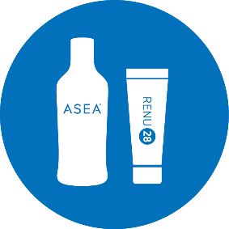


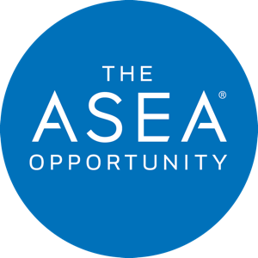


PRODUCTS
COMPENSATION
PLAN
PARTNERSHIP
SYSTEMS & SUPPORT
TIMING
Notes:
I want to talk to you about some of the advantages that my company, ASEA, has to offer.

Slide 15
PRODUCTS
Notes:
Let’s start off talking about the products.

Slide 16

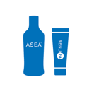
THE PRODUCTS
ONE OF
A KIND
CUTTING EDGE
MASSIVE DEMAND
HIGH IMPACT
PATENTED VALIDATED
CONSUMABLE
Notes:
ASEA’s products are a key part of what make the opportunity so compelling. Think of it this way. When deciding on an opportunity to market a product, what would be important to you? Would you want products that are one of a kind, cutting edge, in massive demand, and that have a high impact? What about something consumable? You want people to need more, right? And it’s probably safe to say you would want it to be valid, maybe even patented.

Slide 17
HEALTH AT THE CELLULAR LEVEL
We live and die at the cellular level
YOU
When cells are healthy, we are healthy
SYSTEMS
ORGANS
TISSUES
CELLS
REDOX SIGNALING
Notes:
ASEA’s products are based on cellular health. We know that impacting the health of our cells has a significant impact on the health of all body systems and can impact our overall health.

Slide 18
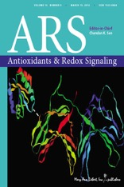



SCIENTIFIC VALIDATION
10,000+ peer reviewed articles published on redox signaling.
Nobel Prize in Physiology and Medicine each year dating back to 2011 has been awarded on work discovered or performed at a cellular level.
Notes:
And this redox science is not new! Scientists have been researching redox signaling for decades. In fact, multiple Nobel prizes have been awarded for discoveries related to this field of cellular messaging, and more than 10,000 scientific papers have been written on the subject.

Slide 19

WHAT IS REDOX SIGNALING
& HOW DOES IT AFFECT ME?
As we age, we produce fewer and fewer Redox Signaling Molecules.
YOU WILL BEGIN TO SEE AND FEEL THE EFFECTS OF AGING
DEFICIENCIES AND IMBALANCES IN REDOX FUNCTION
Notes:
And what they have discovered is that redox signaling molecules are tiny cellular messengers that function at their best when we are young. In fact, the breakdown in cellular communication that accompanies aging can be seen as one of the main causes of aging itself!

Slide 20

REDOX BREAKTHROUGH
After two decades, millions of research dollars, a team of scientists achieved the “impossible.”
They stabilized redox signaling molecules outside of the body in perfect balance as they are found in healthy cells.
Notes:
Problem was, up until ASEA, there was no way to supplement these redox signaling molecules. But after two decades and millions of research dollars, a team of scientists achieved the impossible: They stabilized redox signaling molecules outside of the body in as perfect a balance as they are found in healthy cells.

Slide 21
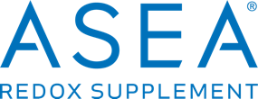
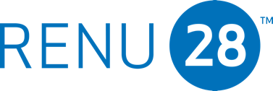
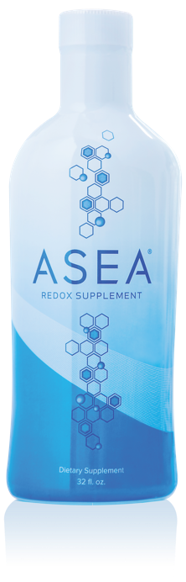

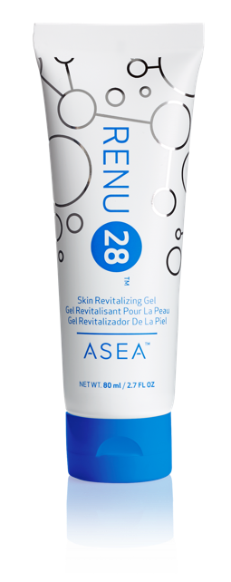


ASEA is the ONLY place
in the world where you can get these two exclusive, breakthrough products.
100% Safe
Non-Toxic
Notes:
ASEA’s two products are a result of this heavily patented, groundbreaking technology. And they are certified by a prestigious third-party lab to contain active redox signaling molecules (Call out BioAgilytix certification.)

Slide 22

The most advanced anti aging skin therapy ever brought to market.
Simple
Safe
Proven
Affordable
Effective
Notes:
Let’s take a look at RENU 28, ASEA’s Skin Revitalizing Gel. It is simple, safe, proven, affordable, and effective.

Slide 23
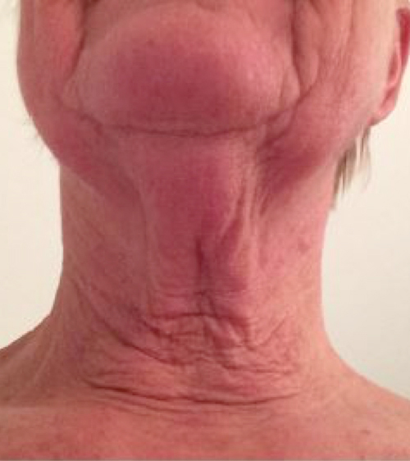
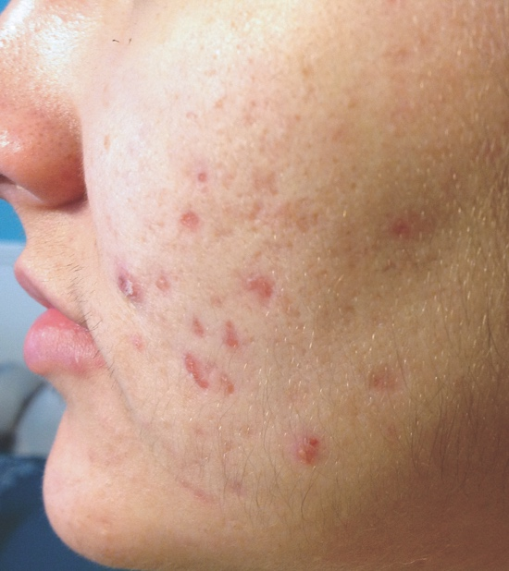
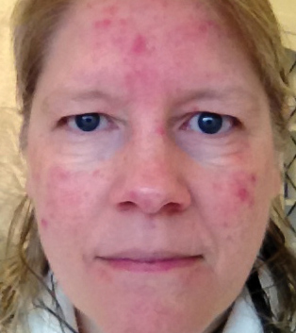
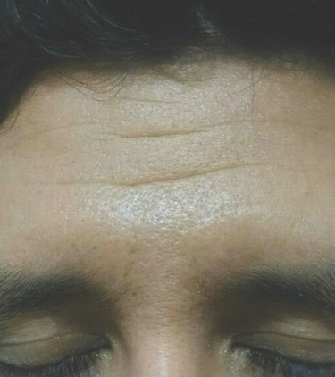
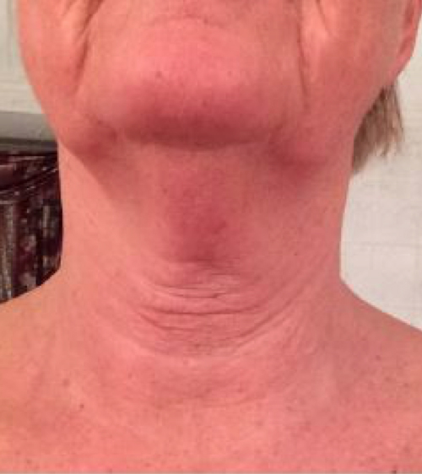
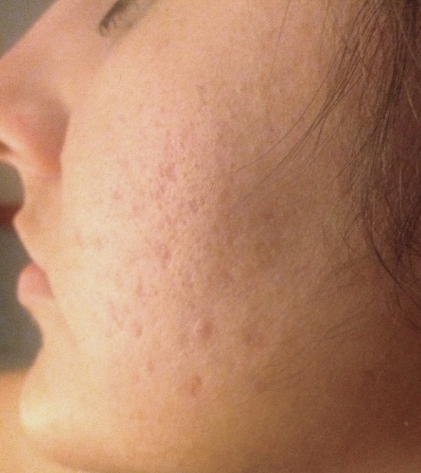
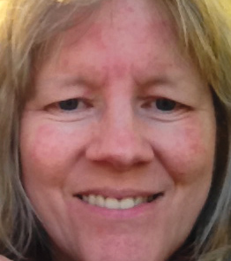
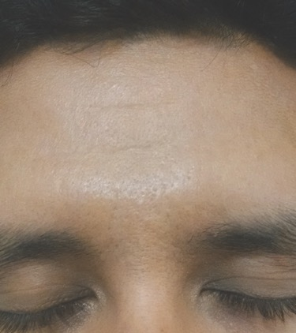
Notes:
Look at these other amazing before and after photos.

Slide 24
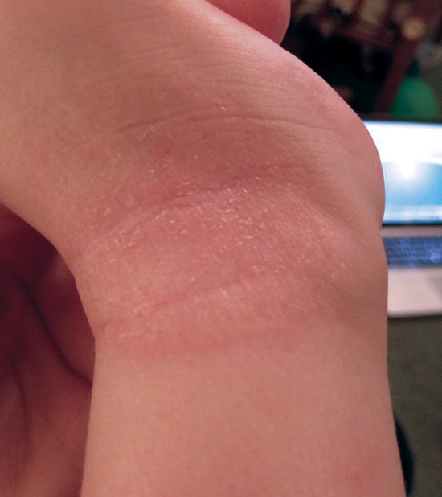
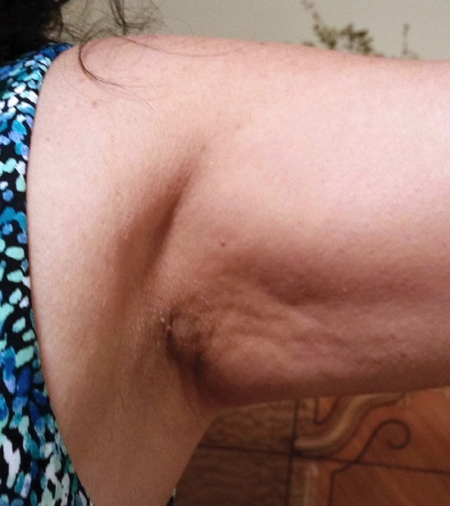
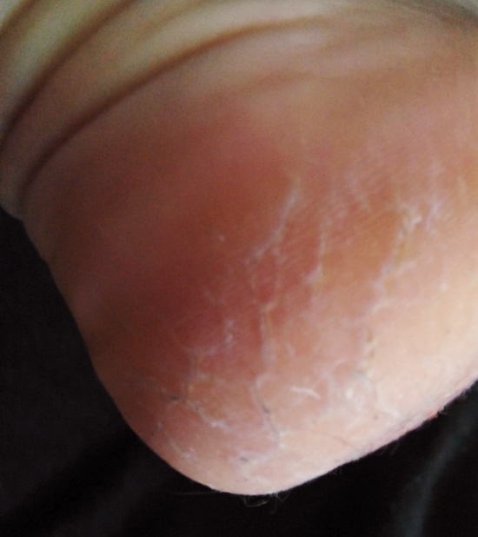
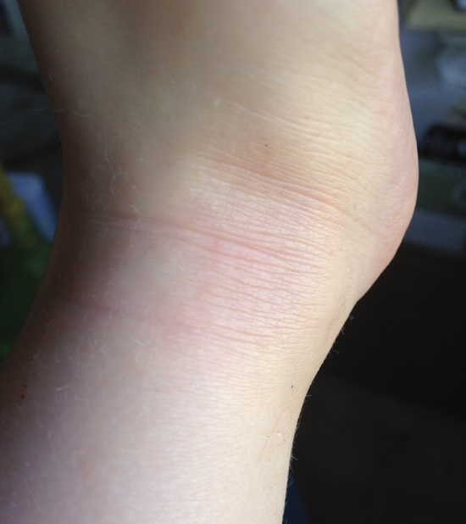
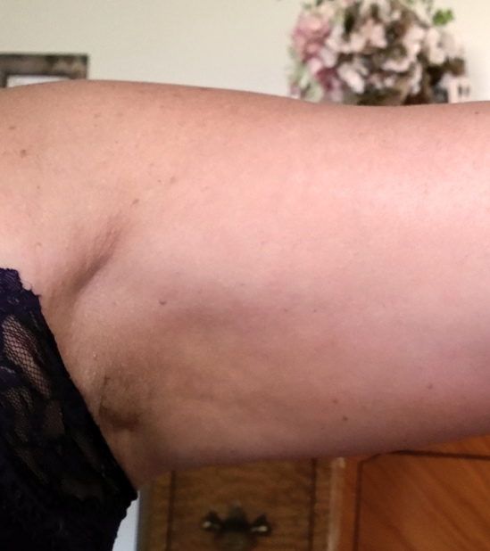
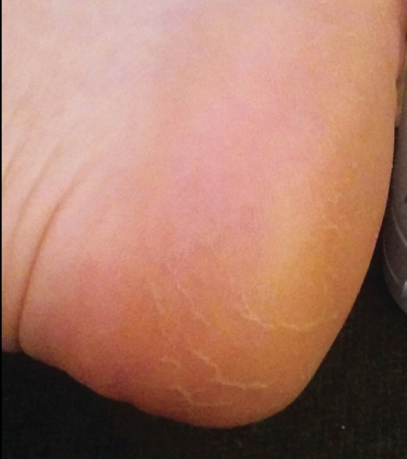
Notes:
And RENU 28 is not just for the face!

Slide 25
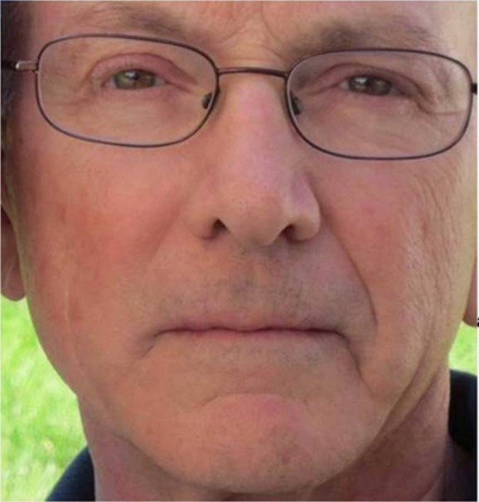
RENU 28 RESULTS
28 Days applying RENU 28
NO
RENU 28
Notes:
Take a look at Dr. Marty Morin’s personal results with RENU 28. This photo shows the treated and untreated sides of his face. Can you tell which is which? If you think he used it on the right side, raise your hand. Now, if you think he used it on the left. If you said right, you’re right.

Slide 26
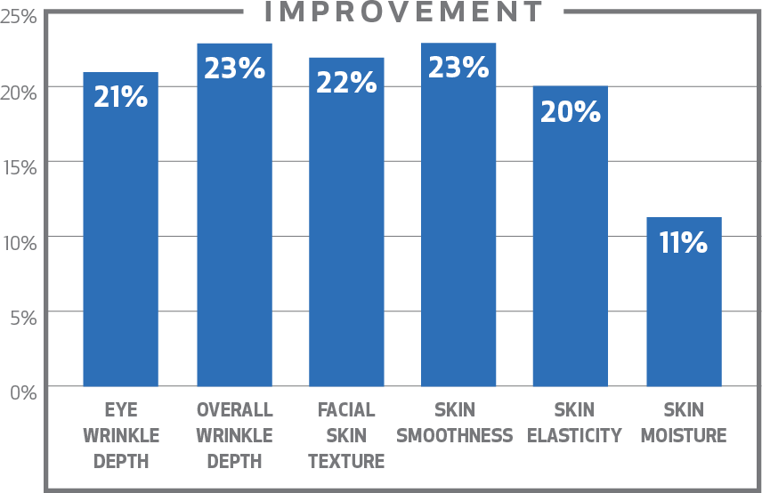


RENU 28 VALIDATED BY SCIENCE
Non-toxic; safe for the whole family
20% improvement in appearance of wrinkles and elasticity
Visible reduction in redness
and irritation
16% faster skin cell renewal
50% increase in skin blood flow
15% reduction in the appearance
of cellulite
Stephens
Excellence in Research
Notes:
Studies prove it, showing that RENU 28 improves the appearance of lines and wrinkles associated with aging, increases skin cell renewal, and increases blood flow to skin.
Check out this last bullet point—RENU 28 helps improve the appearance of cellulite. Lets take a closer look at that—and I need to warn you—ladies, where is it that most people notice cellulite? Yep, the bum. So you are going to see some bums in this next slide.

Slide 27
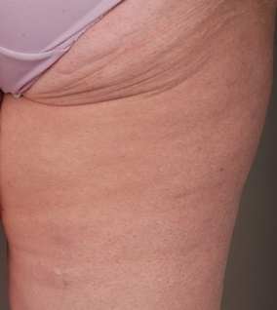
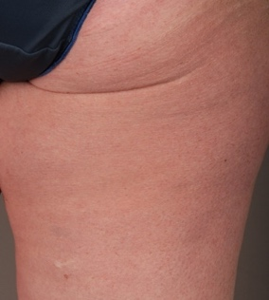


DERMATEST 12 WEEK CLINICAL STUDY
Results reveal:
20.91% increase in skin elasticity
15.81% improvement in the
appearance of cellulite
Notes:
Here are the latest results from a third-party clinical study performed on our products effectiveness at reducing the appearance of cellulite
Click
And here are some before and afters from the study.

Slide 28

Notes:
Now let’s look at ASEA Redox Supplement. This is the flagship product, and it provides benefits from the inside out.

Slide 29
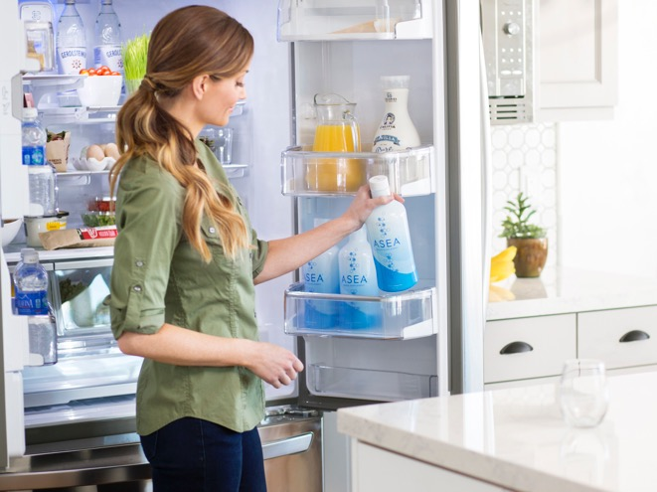
WHY YOU NEED
ASEA REDOX SUPPLEMENT
ASEA Redox Supplement benefits every system of the body. Redox signaling molecules:
Anti-aging benefits
Empowers your body’s natural processes to function optimally
Improve athletic performance and recovery
Notes:
The redox signaling molecules in ASEA Redox Supplement benefit every system of the body. They can actually upregulate important antioxidants, provide critical cellular communication, and improve athletic performance and recovery.

Slide 30
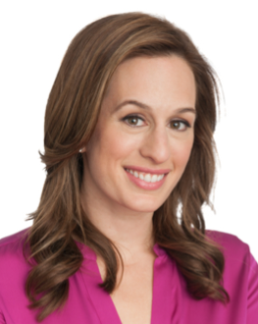
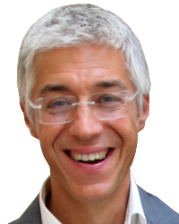
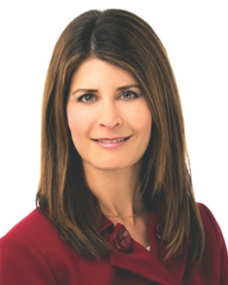
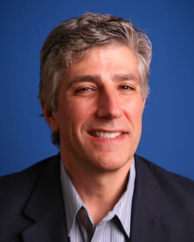
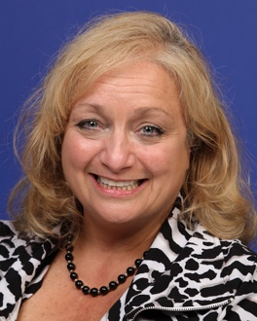
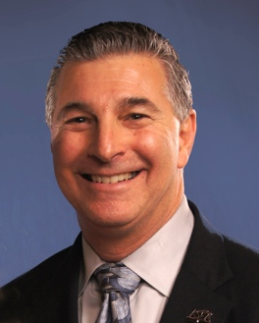
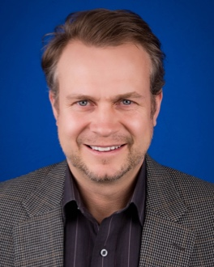

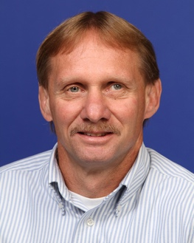
ASEA SCIENCE COUNCIL
Brooke Alpert MS, RD, CDN
Dr. Giuseppe Maffi
Karen R. Stolman
MD
MEDICAL PROFESSIONALS BOARD
Dr. David Silverman DPM
Dr. Maureen Hayes MD
Dr. Foster R. Malmed
DC, PC
Dr. Karl V. Smith
DC
Dr. Stan Gardner MD
Shawn Burke PTA, CPT
Notes:
But don’t just take our word for it. ASEA has a board of prestigious scientists and medical professionals who validate the science of redox signaling and the research behind ASEA Redox Supplement and RENU 28. Check out what some of these experts have to say:

Slide 31

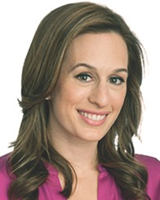

ASEA SCIENCE COUNCIL
“I am astonished by the science and research that have shown how effective ASEA's Redox Supplement is. The only way to reach true health and wellness is by working at the cellular level and this supplement is a one of a kind solution for impacting cellular health at its core level.”
—Brooke Alpert, MS, RD, CDN
“As we age, our skin cells lose efficiency in their usual daily functions, such as protecting us from the harmful effects of sun, resulting in visible signs of age and fading beauty. When we supplement our skin with redox signaling molecules, we jumpstart the cell function so they can better fight environmental insults and maintain our youth and beauty.”
—Karen R. Stolman, MD
Notes:
(read quotes)

Slide 32






ASEA ATHLETES
Notes:
Elite athletes also feel the ASEA difference. Here are a few of the many world-class athletes benefitting from ASEA Redox Supplement.

Slide 33
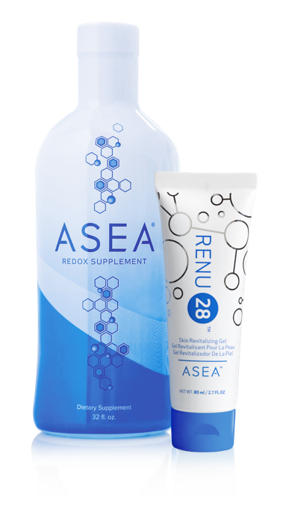
ADVANCED ANTI-AGING TECHNOLOGY
Feel Better with ASEA
Anti-Aging from the Inside Out
Look Better with RENU 28
Anti-Aging from the Outside In
Harnessing the Power of
Redox Signaling Molecules
Notes:
Hopefully you can see how cutting-edge these products are, that you are really seeing the nature of these products, the kind of demand we’re talking about, how they will work for you, and the proven science behind them.
(This is a great place to have people from your team talk about the positive impact ASEA Redox Supplement has had on their health.)

Slide 34
PRODUCTS
PARTNERSHIP
Notes:
ASEA understands what it takes to be a good business partner.

Slide 35


PARTNERSHIP
Foundation of integrity
Financially strong and stable
International presence
Notes:
This is a company that is built on a foundation of integrity, that is sound and stable financially, and that has a growing international presence.

Slide 36
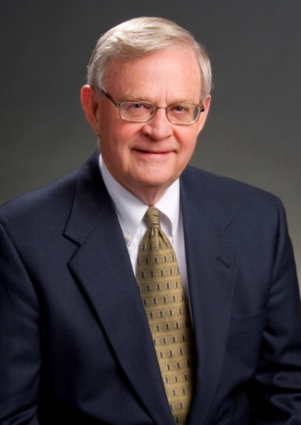
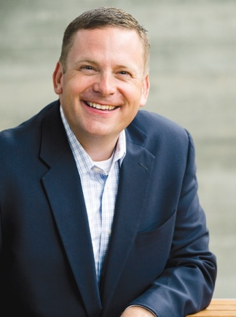
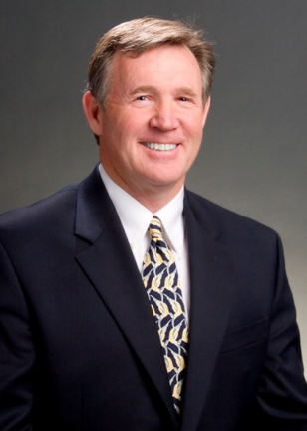
FOUNDATION OF INTEGRITY
Verdis Norton
Tyler Norton
James Pack
Verdis Norton, Tyler Norton and James Pack bought a compelling technology from a struggling biotech company as a business investment.
Examining the technology more closely with a team of researchers,
they discovered how to take the technology to a new level by stabilizing the molecules.
Notes:
Let me tell you a little about the founding of ASEA. It was born out of an idea that was little more than a business strategy: take a cool product concept, develop it, and sell it. But what the founders of ASEA didn’t know was the difference that this product would make in the lives of the people who used it. Once they saw that, they knew they couldn’t just move on. They actually passed on an opportunity to sell the technology to a major pharmaceutical company because they had a vision of reaching more people. They chose the network marketing business model for bringing redox signaling technology to the world.

Slide 37
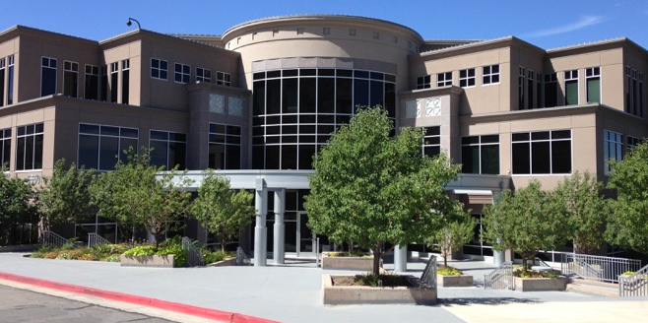
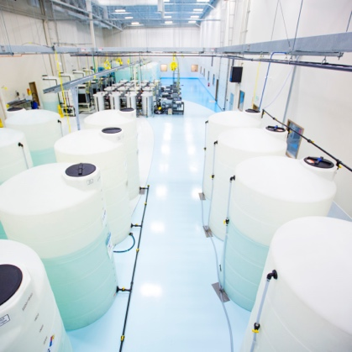
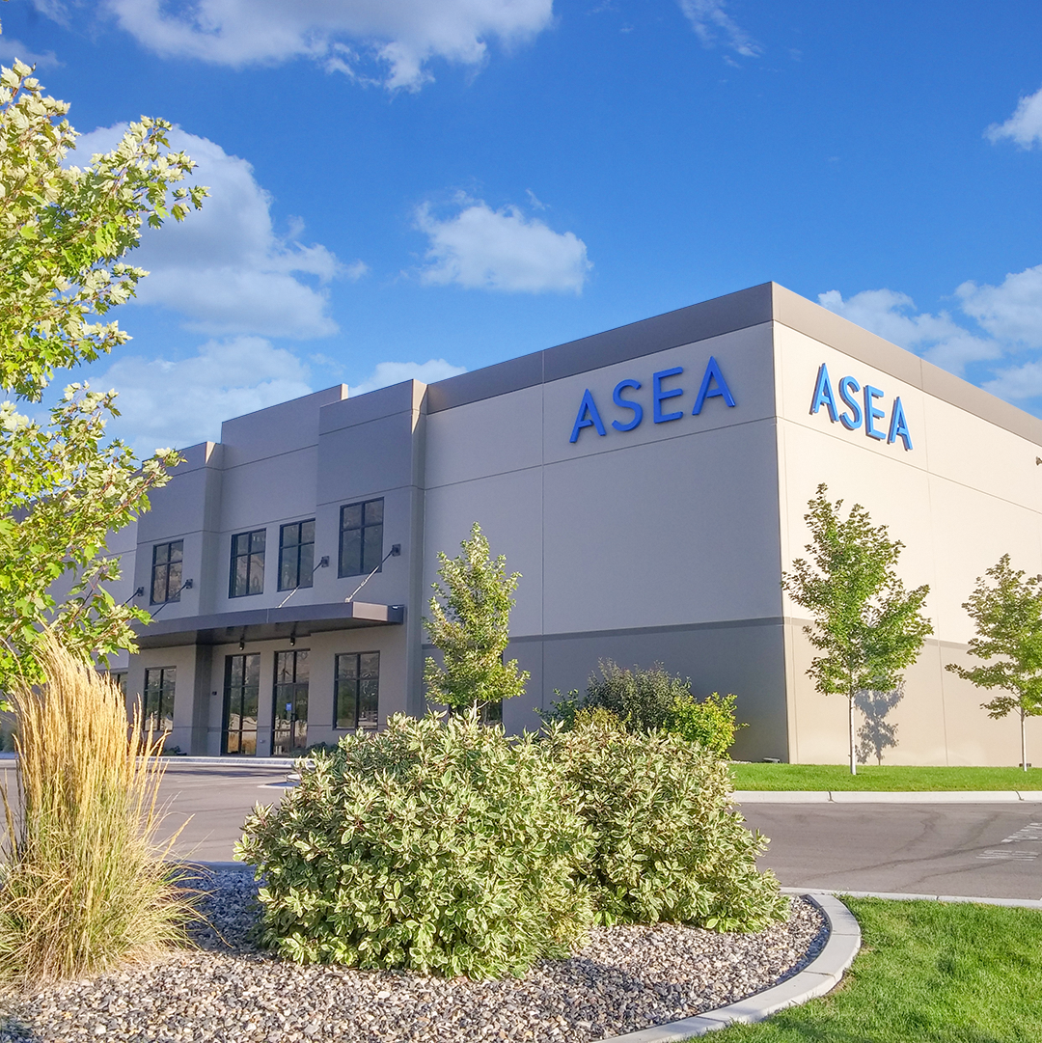
FINANCIALLY STRONG & STABLE
Profitable every year
since inception
Carries no debt
Scalable infrastructure—
capacity of $800 million
Highest quality standards (FDA registered, GMP, NSF compliant production facility)
Notes:
ASEA is rock solid financially. Profitable every year since its birth, the key business indicators show that ASEA is ready for years of solid growth.

Slide 38
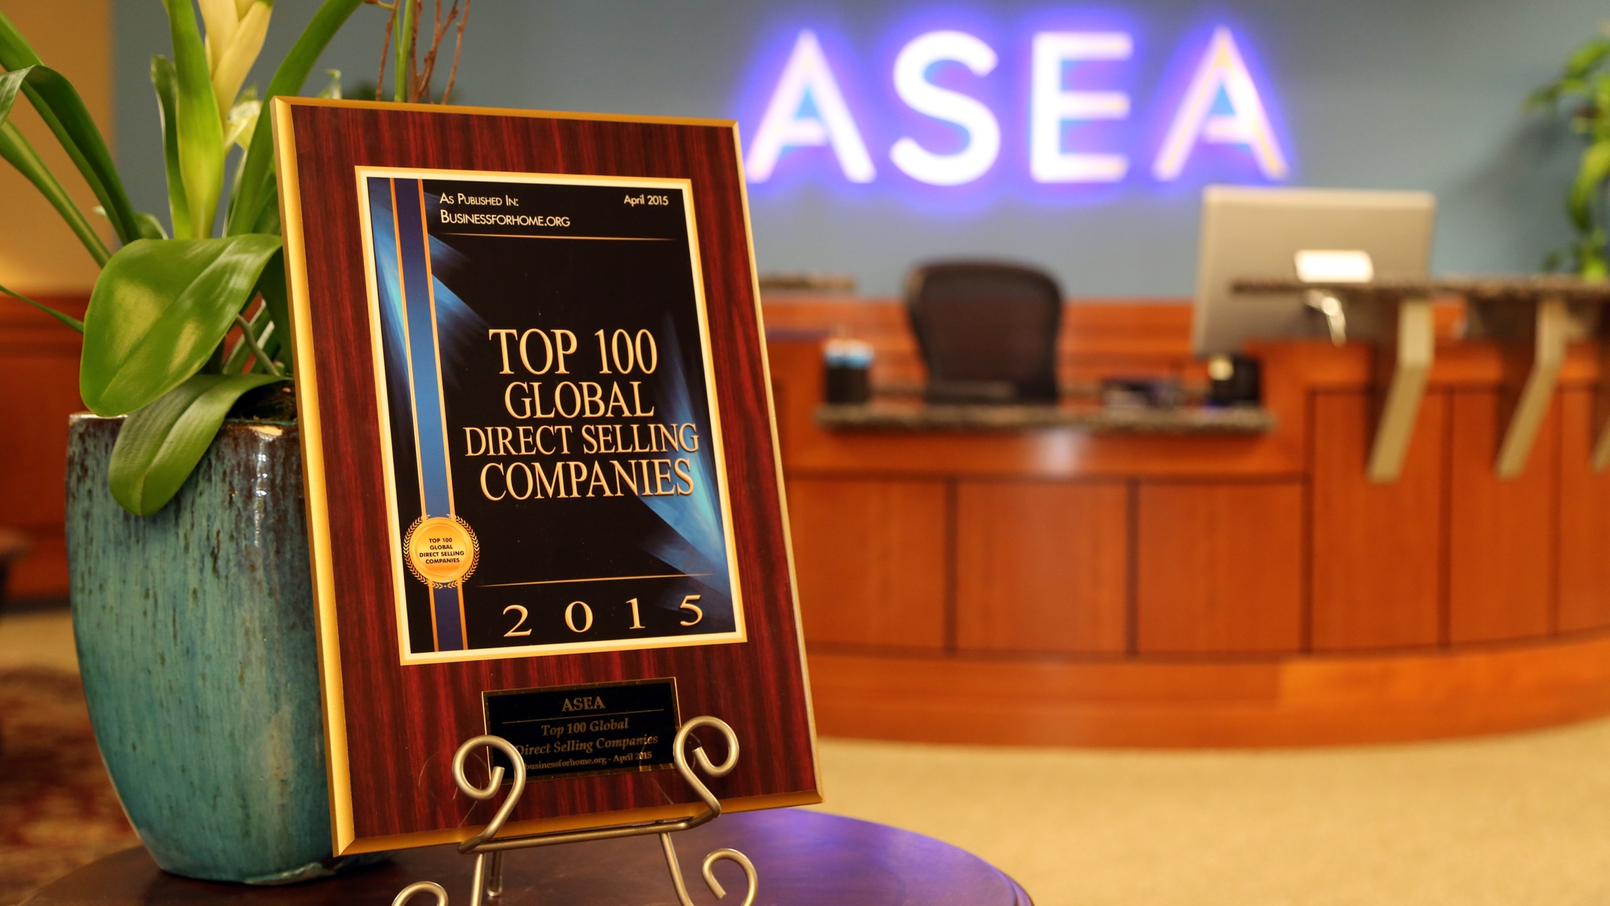
Notes:
In fact, ASEA was just recognized by the DSA as one of the top 100 companies.

Slide 39

ASEA MARKETS WORLDWIDE: 25
Notes:
Take a look at the international markets where ASEA is available and operating. You are not limited by international boundaries. Everyone in this room should be thinking, “Who do I know in those countries?”

Slide 40
PRODUCTS
COMPENSATION
PLAN
PARTNERSHIP
Notes:
The company’s compensation system is yet another reason to partner with ASEA. Let’s talk about how you make money.

Slide 41

COMPENSATION
Leveraged Income
Residual Income
Part Time or Full Time
Legacy Income
Commissions Paid Weekly
Notes:
This is called the compensation plan, and ASEA’s is one of (if not THE) most generous out there, profitable at every stage of the business cycle.

Slide 42


ASEA INCOME IS POWERFUL
LEVERAGED Income
Earn beyond yourself and build a distribution network of like-minded, self-motivated people … just like YOU!
RESIDUAL Income
Industry-leading retention rates mean repeat purchasing over time
Cutting-edge, consumable products
Meaningful results in people’s lives
No competition, no copycats!
Notes:
ASEA helps you create income that is both leveraged and residual. Let’s talk about why this is such a powerful income opportunity. First, leveraged income allows you to work together with a team because you’re leveraging the efforts of others. In all businesses, when somebody buys something, somebody gets paid. If you made that connection, why shouldn’t it be you being paid? ASEA makes sure that happens. You make a retail profit on every sale you facilitate.

Slide 43
PILLARS OF COMPENSATION
CHECK MATCH
EXECUTIVE MOMENTUM POOL
TEAM COMMISSIONS
DIRECTOR BONUS
FAST START
CUSTOMERS
RETAIL
IMMEDIATE INCOME TO PART TIME
FULL TIME TO UNLIMITED INCOME
Notes:
Here are the seven different ways you can make money at ASEA. You can see them divided here into categories—Immediate to Part Time, and Full Time to Unlimited, or as we like to call it, Big Time income.
Let’s take a look at just one: team commissions. Again, this is just one of the seven ways you can get paid with ASEA and, as a side note, it’s not even the most lucrative commission mechanism in the pay plan.

Slide 44







HELP TWO PEOPLE GET STARTED WITH ASEA IN TWO WEEKS
Week 0
Week 2
One Month
Notes:
Now I’d like to give you an example of the earnings potential with just one of the seven commission mechanisms, known as Team Commissions. Again, this is just one of the seven ways you can get paid with ASEA and, as a side note, it’s not even the most lucrative commission mechanism in the pay plan.
The team commission part of the plan is based on twos. Think about it—out of everyone you know, do you think you can find at least two people who would like the amazing health benefits of ASEA Redox Supplement and RENU 28 and who could also use more income? Could you find these two people within two weeks? If so, this is what it would look like.
(click)
In the following two weeks, the two people you found go out and find their two people.
(click)
So now, you see you have a total of six people by the end of your first month.

Slide 45
Week | New Associates | Total Associates | Monthly Potential Residual (100PV) | Monthly Potential Residual (150PV)
2 | 2 | 2 | $10 | $15
4 | 4 | 6 | $30 | $45
6 | 8 | 14 | $70 | $105
Help two people get started with ASEA in two weeks
…and help them do the same
8 | 16 | 30 | $150 | $225
10 | 32 | 62 | $310 | $465
12 | 64 | 126 | $630 | $945
14 | 128 | 254 | $1,270 | $1,905
16 | 256 | 510 | $2,550 | $3,825
18 | 512 | 1022 | $5,110 | $7,665
20 | 1024 | 2046 | $10,230 | $15,345
22 | 2048 | 4094 | $20,470 | $30,705
24 | 4096 | 8090 | $40,000 | $40,000
Notes:
Now, since these people want to get the health benefits from ASEA Redox Supplement, the only thing required in this example is that they are drinking at least one case for themselves.
(click)
The far right column shows potential income if they are also using two tubes of RENU 28 each month. No one has a single customer in this entire illustration except for themselves.
Now, over the next two weeks (click) eight new people come into your group and you now have 14 people total. Let’s push down to four and a half months later (click). At week 18, you now have a total 1,022 people in your group which is generating you $5,110 per month if they are just using one case of ASEA Redox Supplement for themselves, and it would be $7,665 a month if everyone was also using two tubes of RENU 28. Now as a trivia question, how many people did you find in this example? That’s right, just two!
Everyone only found two people, and they took the entire two weeks to do so. Now to draw a parallel, $5,000 a month is the interest you would earn if you had approximately 6 million dollars in the bank at 1% interest.
(click) If we push down to week 24, you have more than 8,000 people in your group, generating you over $40,000 a month in passive, monthly, residual income.
Now, we don’t live in a perfect world and I’ve never seen this happen in this exact perfect way, but even if this example was a 90% failure, that’s still $4,000 a month in passive, monthly, residual income. That’s more than most people receive in retirement after working 30-40 years. Doing what you are currently doing now, if you were a 90% failure, would you be able to stop working in 6 months and have your company pay you $4,000 every month, month after month? Probably not, even if you were a 100% success!

Slide 46





WHAT DO YOU WANT TO ACHIEVE?
Bronze
Gold
Platinum
Triple Diamond
ASEA has paid out over $100 Million to thousands of Associates. Multiple Millionaires!
Notes:
Here’s what I’m telling you: the ASEA opportunity can be for you what you make it.
At the Bronze level, you can bring in enough to pay a mortgage.
At Gold, it’s enough to pay college tuition.
At Platinum, you’re making, say, what a lawyer makes.
And a Triple Diamond, you might be making what a well-paid surgeon makes.

Slide 47
PRODUCTS
COMPENSATION
PLAN
PARTNERSHIP
SYSTEMS & SUPPORT
Notes:
Yet another reason to partner with ASEA. Let’s talk about how you make money.

Slide 48


SYSTEMS & SUPPORT
You are not alone
Personal development
Events and incentives
Your team
New friendships/relationships
Notes:
When you join ASEA, you become part of us. You will be able to participate in the local ASEA community via your team.

Slide 49



WORLD-CLASS
SUPPORT SYSTEMS AND TOOLS
Starter Kit
ASEA
Business Coach
Back Office
Notes:
ASEA provides professional tools and training so that even the newest business partner can succeed.

Slide 50



ASEA’s personal development roadmap to success.
Notes:
One of the many success strategies the company embraces is its Peak Performance Program, the roadmap to success.

Slide 51








Notes:
You will participate in events and incentive trips and get to know corporate leaders as well as field leaders from other areas who are building their own businesses around the country and the world. And you will have the opportunity not only to participate in this community, but to help build it for your own team.

Slide 52
PRODUCTS
COMPENSATION
PLAN
PARTNERSHIP
SYSTEMS AND SUPPORT
TIMING
Notes:
I want to talk to you about some of the advantages that my company, ASEA, has to offer.

Slide 53


TIMING
Once in history timing
Notes:
A few points that are going to help you understand the urgency around this opportunity.
(read bullets)

Slide 54

ONCE IN HISTORY TIMING
Notes:
ASEA is a company that is just hitting its stride. What do you think of when I say post-risk, pre-momentum?
(pause)
ASEA has already taken the risk. The science has been proven. People all over the world are starting to take advantage. But we are still at the beginning of our growth momentum phase, and that is the right time to join. In fact, ASEA was recently recognized as being the 12th fastest growing company in the state of Utah—a state with one of the strongest economies in the country.

Slide 55
PRODUCTS
COMPENSATION
PLAN
PARTNERSHIP
SYSTEMS & SUPPORT
TIMING
Notes:
OK, now that you know all the things that set ASEA apart from other companies, I want to come back to that question of what life looks like to you right now.

Slide 56

WHAT ARE YOU LOOKING FOR?
Are you tired of the
daily grind?
Do you have financial goals
you want to meet?
Are you looking for more purpose and excitement?
Do you have the freedom
and flexibility to do what
you want?
Notes:
(Read bullets.)

Slide 57



WHERE DO YOU SEE YOURSELF?
1
2
3
$100–$1000
$1000–$10,000
$10,000
and beyond
Notes:
Now that you’ve seen the ASEA opportunity and what it offers, the question is where do you see yourself?
1. Do you want to earn a few extra dollars? Enough to pay for your product?
2. What about a business opportunity that creates income—even enough to replace a full-time income?
3. Or a great wealth-building opportunity that can help you create a legacy?
Do yourself a favor. Tell person who brought you tonight where you see yourself. Are you a 1, a 2, or 3?

Slide 58
ASSOCIATE ENROLLMENT
Enroll as an Associate:
Activate with a One Time Enrollment Pack
1 case
2 cases
4 cases (Discounted)
8 cases (Discounted)
Discounted Packs ONLY available at time of Enrollment
Notes:
Here are a few of the options for getting started with ASEA. Several ways to enroll. 1 case, 2 cases, get with the person who invited you.

Slide 59


BONUS AUTOSHIP CASE PROMOTION
Only One Case Autoship to Remain Active
The Autoship incentive is for new enrollees through May 13, 2016
Enroll with
1 case minimum
(e.g. Jan)
+
=
1st Month Autoship
(Feb)
2nd Month Autoship
(March)
3rd Month Autoship
(April)
FREE CASE of ASEA or RENU 28
+
=
4th Month Autoship
(May)
5th Month Autoship
(June)
6th Month Autoship
(July)
FREE CASE of ASEA or RENU 28
Notes:
By enrolling today you can take advantage of our Bonus Autoship case promotion. When you enroll today with a 100PV Autoship order, you will be eligible to receive 2 CASES of product for FREE!!

Slide 60



RENU 28 GIVEAWAY PACK
Add 2 tubes of RENU 28
to a 1 case Autoship (150PV)
Giveaway Pack ($30 Value)
Get 6 FREE sample tubes of RENU 28 + RENU 28 booklet and brochures
Notes:
And we have another promotion going on currently: (explain promo)

Slide 61
DAILY ROUTINE
Notes:
Think once again how you felt when we talked about your daily grind. Even if you’re wildly successful at what you do and invest your money, it’s not going to get you a fraction of what you put into it.
What if I told you that you can take a fraction of the effort, lose the grind, be in control of how you earn your money, and create a substantial, sustainable residual income?

Slide 62






RICH REWARDS
Notes:
Isn’t it time you exchange that grind for something more rewarding?

Slide 63


We are all at the start of something big with great purpose and right now is the moment that we begin influencing the future…
We can change the world.
Verdis Norton, ASEA founder
Notes:
I’d like to close with some words from our founder, Verdis Norton (read quote).

